Slide 1
Computer Graphics
Lecture 3: Cameras
Kartic Subr

Slide 2

Lec 2: Recap + Clarification

Slide 3
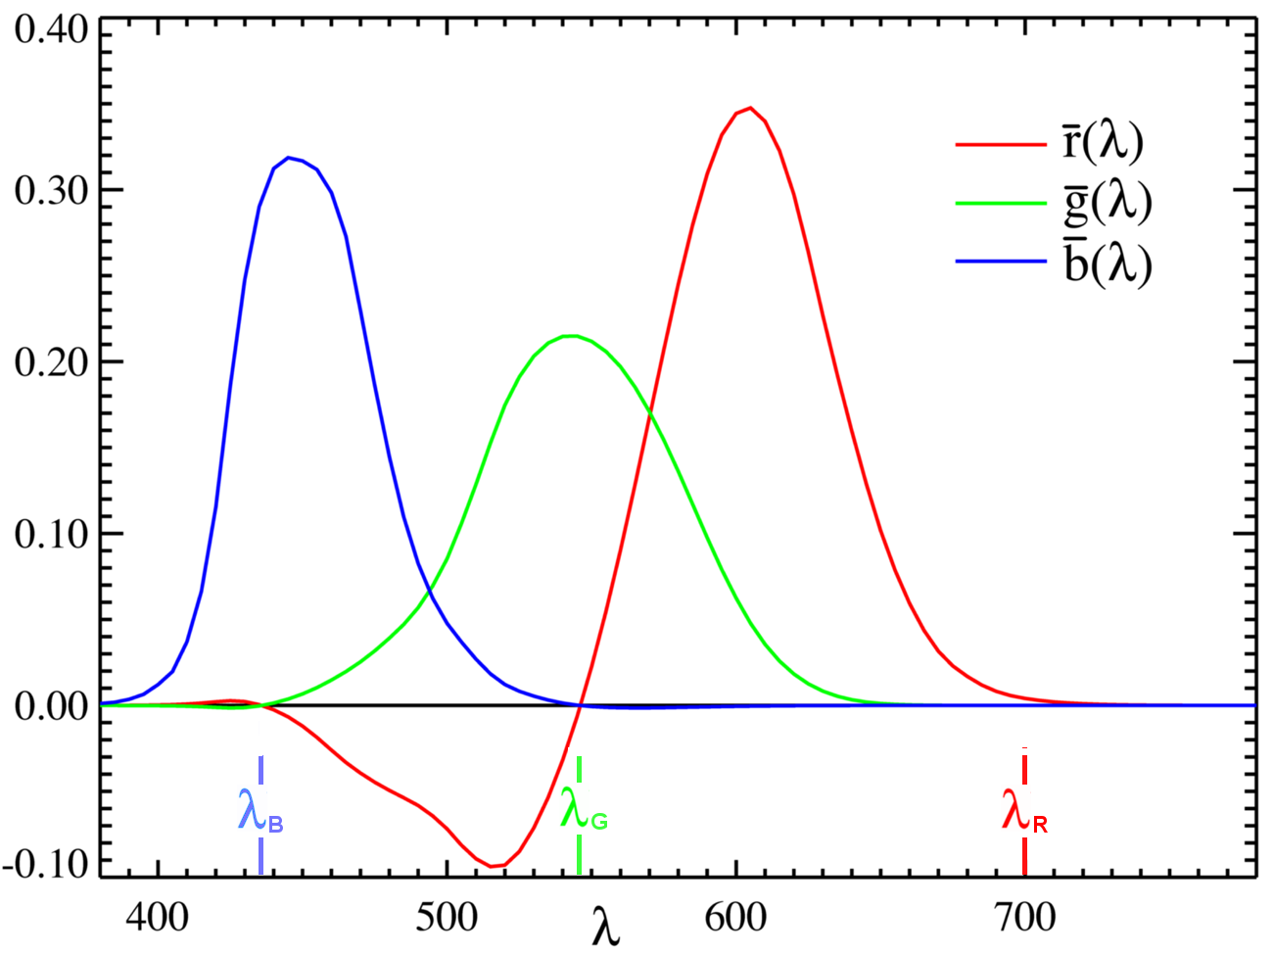

Lec 2: Recap + Clarification
g
r
b

Slide 4

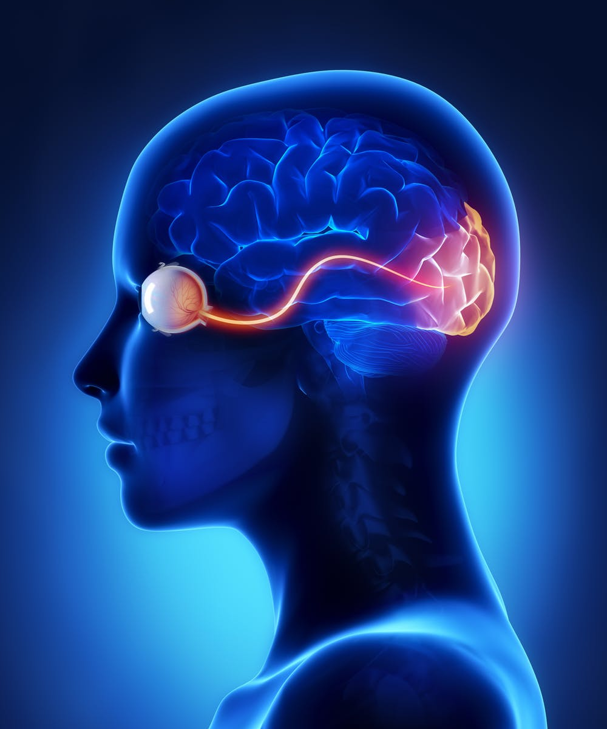
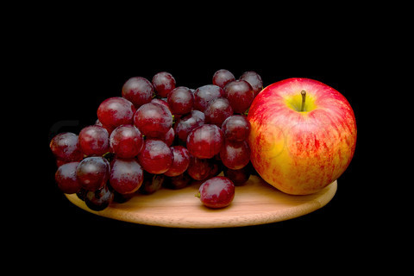
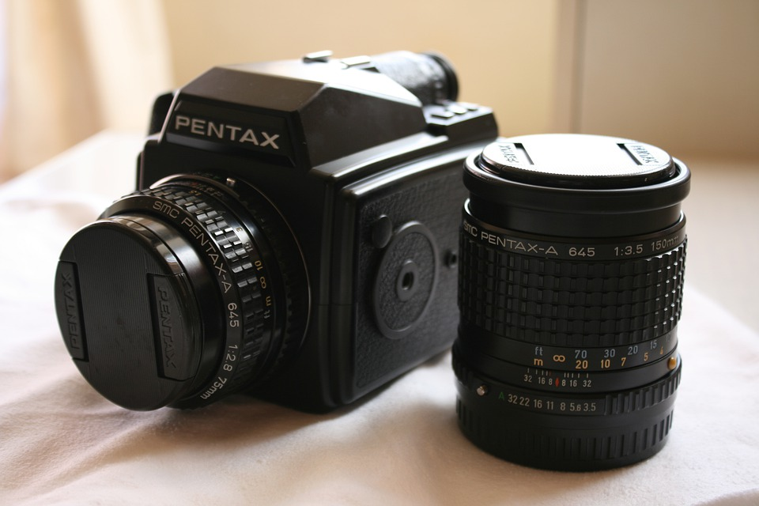

photography
rendering
Virtual

Slide 5
Cameras
Notes:
8 bits per channel
Store energy in the scene
View, color, energy mapping

Slide 6
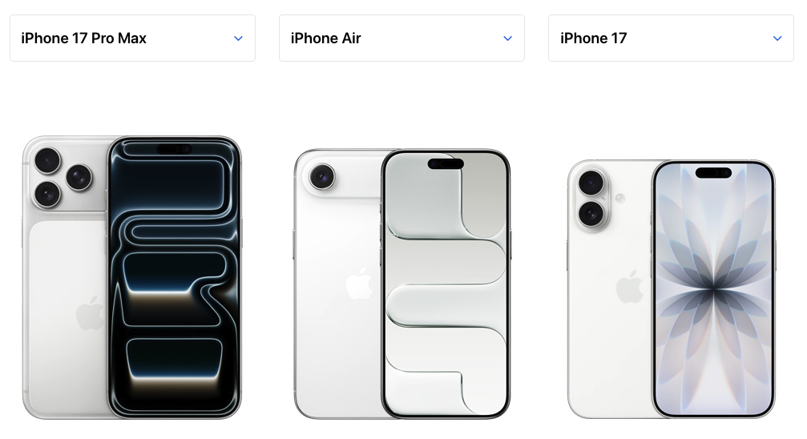
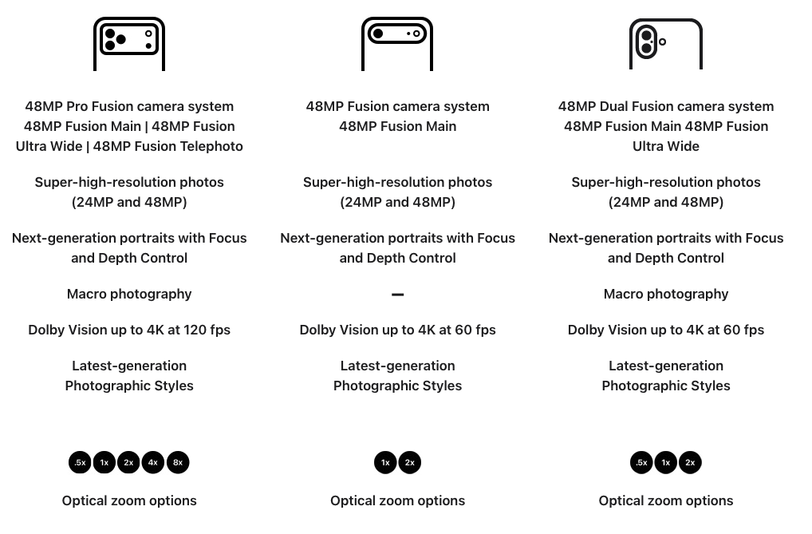

Slide 7
The pinhole camera
Notes:
8 bits per channel
Store energy in the scene
View, color, energy mapping

Slide 8
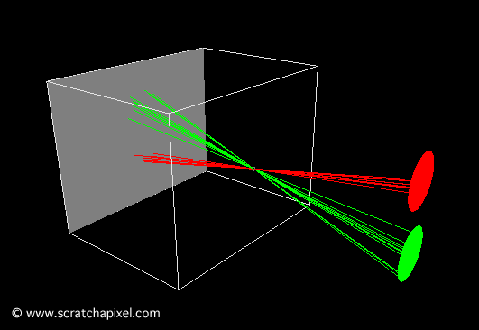
Pinhole camera
Ibn al-Haytham (965-1040 AD)

Slide 9
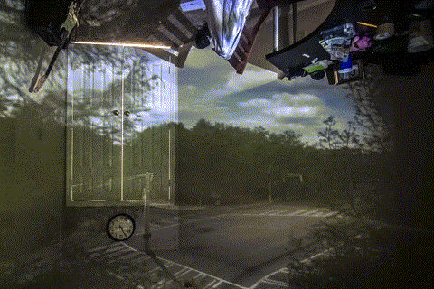
Camera Obscura
The making of …

Slide 10
Projection
Notes:
8 bits per channel
Store energy in the scene
View, color, energy mapping

Slide 11
What is a vector? e.g. 2D
u
v

Slide 12
What is a matrix? e.g. 2x2
a
b
c
d

Slide 13
Can we ‘operate on’ a vector?
a
b
u
au + bv
=
c
d
v
cu + dv

Slide 14

Can we ‘operate on’ a vector?
a
b
u
au + bv
=
c
d
v
cu + dv
operate
result

Slide 15
What operations can it achieve?
what can we say about the new shape?

Slide 16
What operation achieves translation?
?
u
c_{x}
+
v
0

Slide 17
Can we achieve this with a matrix?
?

Slide 18
Can we achieve this with a matrix?
?
Ans: Not with a 2x2 matrix

Slide 19
What if we add a dimension?
a
b
c
u
d
e
f
v
g
h
i
1
matrix is 3x3
still 2D vectors

Slide 20

Now, translation is possible as an operation
1
0
c_{x}
u
u + c_{x}
0
1
c_{y}
v
=
v + c_{y}
0
0
1
1
1

Slide 21
Homogeneous coordinates are useful!
u'
u’/s
equivalent to
v’
v’/s
s
1
point in 3D homogenous space
point in 2D space

Slide 22

Homogeneous coordinates are useful!
u'
u’/s
y
equivalent to
v’
v’/s
x
s
1
(u’/s, v’/s, 1)
z=1 plane
z
(u’,v’,s)
point in 3D homogenous space
point in 2D space

Slide 23
Homogeneous coordinates are useful!
u'
u’/s
y
equivalent to
v’
v’/s
x
s
1
(u’/s, v’/s, 1)
z=1 plane
z
x
2x
3x
4x
(u’,v’,s)
y
=
2y
=
3y
=
4y
…
1
2
3
4

Slide 24
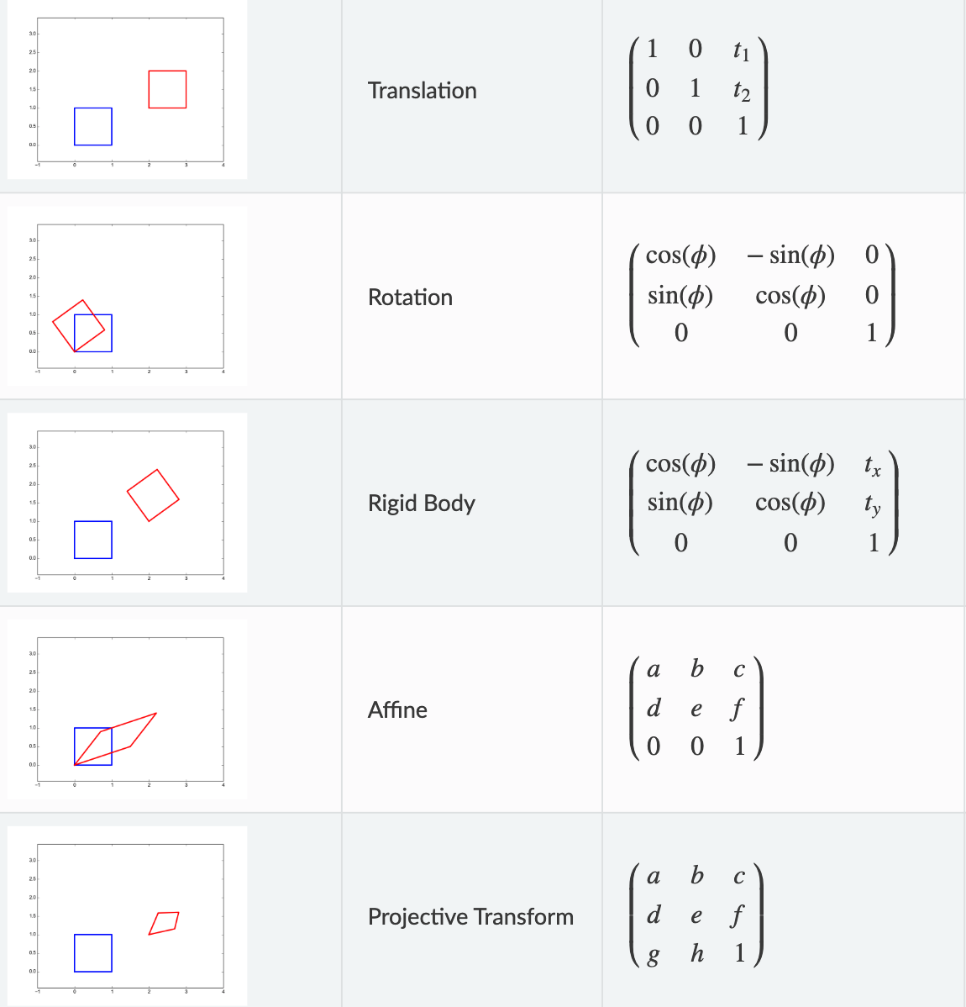
What operations are possible now?
https://staff.fnwi.uva.nl/r.vandenboomgaard/IPCV20162017/LectureNotes/MATH/homogenous.html#sec-homogeneous

Slide 25
Remind you of a camera sensor plane?
Yes, if the camera is at the origin looking down the Z-axis
y
x
(u’/s, v’/s, 1)
z=1 plane
z
(u’,v’,s)

Slide 26




Ideal pinhole camera 3D
f is in the same units as X,Y,Z
2D
image plane
y
$$(X, Y, Z)$$
3D world
$$f$$
$$(−f.\frac{X}{Z},−f.\frac{Y}{Z}, −f)$$
pinhole
z

Slide 27


Ideal vs virtual pinhole model
image plane
$$f$$
virtual pinhole
pinhole
image plane
$$f$$
3D world
3D world

Slide 28





y
2D
image plane
$$(X, Y, Z)$$
3D
$$f$$
$$(f.\frac{X}{Z}, f.\frac{Y}{Z}, f)$$
pinhole
z
$$u$$
fX
f
0
0
0
X
fY
=
Y
$$v$$
0
f
0
0
Z
0
0
1
0
Z
1
1
Pixel coordinates
(u,v)
on z=1 plane

Slide 29

Pixel coordinates from 3D point
1. Projection from 3D to 2D
2. Scaling pixels by pixel resoln.
3. Translation to positive quadrant
f
0
0
0
s_{x}f
0
0
0
f_{x}
0
u
0
0
f
0
0
0
s_{y}f
0
0
0
f_{y}
v
0
0
0
1
0
0
0
1
0
0
0
1
0
4. Skew, if sensor not perpendicular to optic axis
f_{x}
$$α$$
u
0
0
f_{y}
v
0
0
0
1
0
More details here

Slide 30

Pixel coordinates from 3D point
When the camera is at the origin looking towards Z
x
f_{x}
$$α$$
u
0
X
y
0
f_{y}
v
0
Y
1
0
0
1
0
Z
1
2D pixel coordinates
3D world coordinates

Slide 31


Pinhole camera matrix
When the camera is at an arbitrary location
x
f_{x}
$$α$$
u
r11
$$r12$$
r13
t1
X
y
0
f_{y}
v
r21
r22
r23
t2
Y
1
0
0
1
r31
r32
r33
t3
Z
1
2D pixel coordinates
intrinsic
extrinsic
3D world coordinates

Slide 32

Problems with pinhole camera?

Slide 33
Pinhole only allows little light through
faint image

Slide 34


Large hole: many superposed images
blurry image
but more light!

Slide 35
Can we improve light and avoid blur?
blurry image
but more light!

Slide 36

Lens improves light efficiency, but …
sharp image
more light!
lens

Slide 37

… only focusses part of the world
blurry image
lens
depth of field
range of depths for which image is sharp

Slide 38
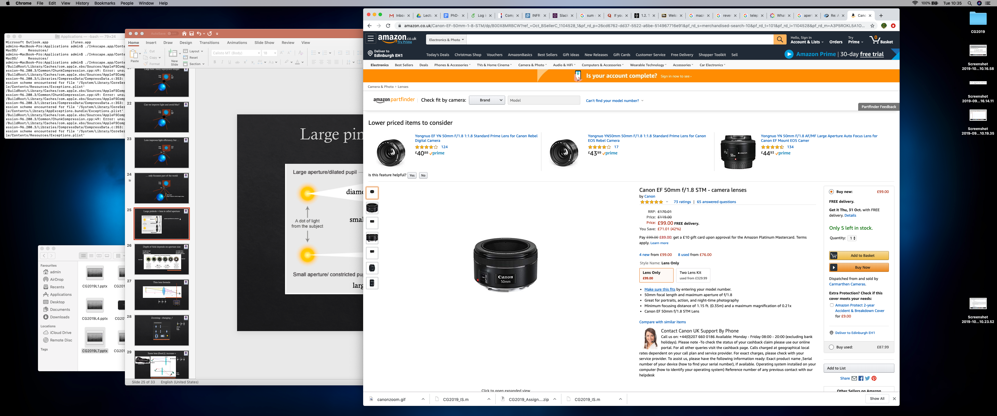

Finite-sized pinhole = aperture
$$\frac{f}{D}$$
aperture specification is a fraction:
diameter D
called f-number of a lens
small fraction
large fraction
https://www.dpreview.com/forums/post/59717839
amazon purchase

Slide 39
Depth of field depends on aperture size
more light allows fast shutter speed – good for dark scenes
less light but large depth of field –
good for landscape
'fast lens’
‘slow lens’
https://www.zippi.co.uk/thestudio/landscape-photography/aperture-diagram-indiahikes/

Slide 40

Thin lens formula, independent of aperture
https://byjus.com/physics/derivation-of-lens-formula/
$$\frac{1}{f}= \frac{1}{u}+ \frac{1}{v}$$

Slide 41
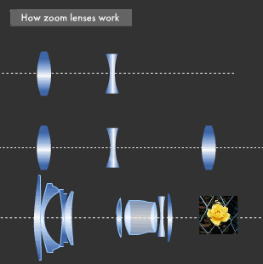

Zooming-- changing f
$$\frac{1}{f}= \frac{1}{u}+ \frac{1}{v}$$
effective focal length
https://global.canon/en/technology/s_labo/light/003/02.html

Slide 42


Same lens (fixed f), increase v
$$\frac{1}{f}= \frac{1}{u}+ \frac{1}{v}$$
extension tube
larger image!
https://expertphotography.com/difference-between-macro-micro-and-close-up-photography/

Slide 43

Also achieved by swapping subject and sensor!
$$\frac{1}{f}= \frac{1}{v}+ \frac{1}{u}$$
reverse ring extension tube
https://121clicks.com/tutorials/use-reverse-ring-extension-tube-macro-photography

Slide 44

Macro photography
high magnification ratio
$$\frac{h_{i}}{h_{o}}$$
35 mm sensor
h_{o}
h_{i}
macro lens
image
object
sensor

Slide 45
Types of lenses
telephoto
f larger than length of lens construction
useful to zoom
compresses range of depths
usually variable focal lengths
and variable f-number (depending on f)
standard/prime
f fixed
no zoom capability
usually high quality build = better image quality
wide angle
f shorter than lens construction
good for landscape
could introduce more distortion

Slide 46
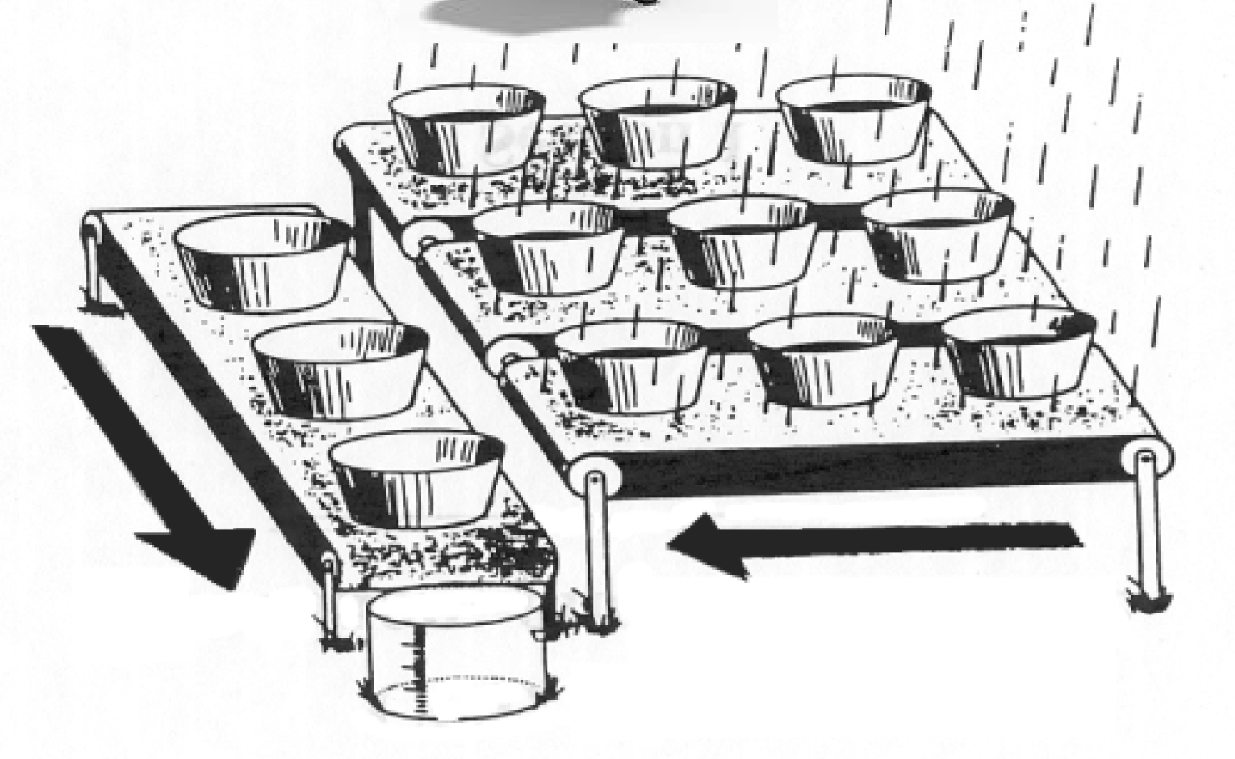
Cameras – sensors
https://www.visiononline.org/userassets/aiauploads/file/cvp_the-fundamentals-of-camera-and-image-sensor-technology_jon-chouinard.pdf
Notes:
8 bits per channel
Store energy in the scene
View, color, energy mapping

Slide 47

Sensor sensitivity and response
Notes:
8 bits per channel
Store energy in the scene
View, color, energy mapping

Slide 48
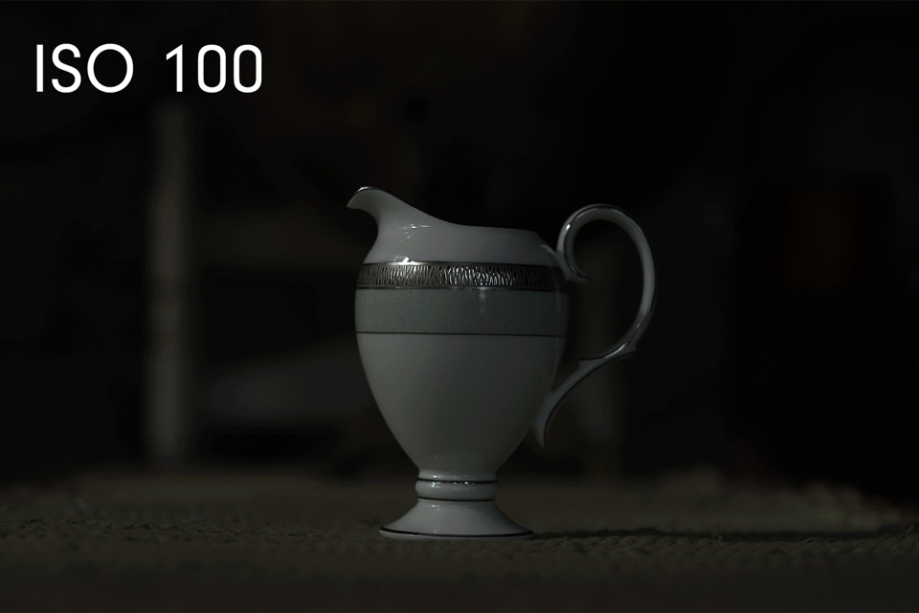
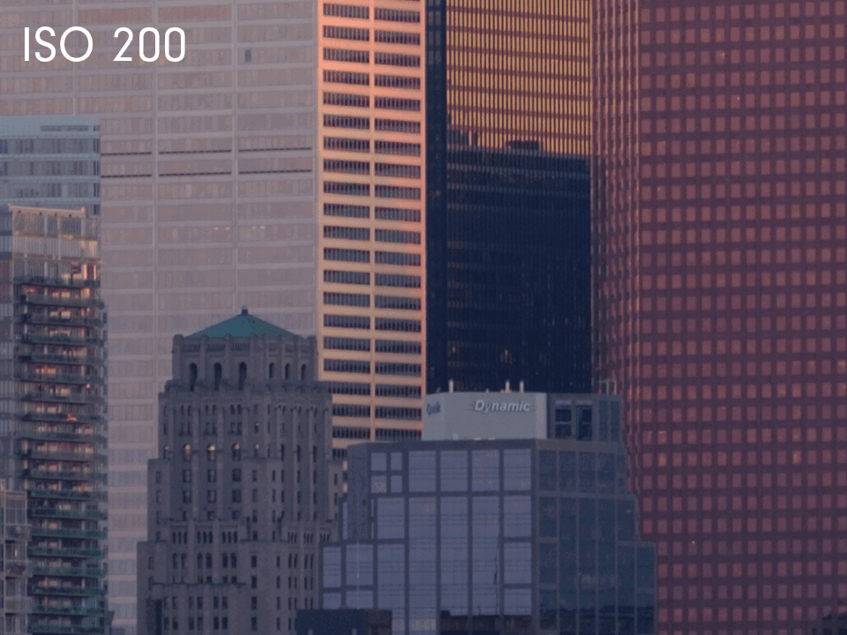
Sensor sensitivity and response
Notes:
8 bits per channel
Store energy in the scene
View, color, energy mapping

Slide 49
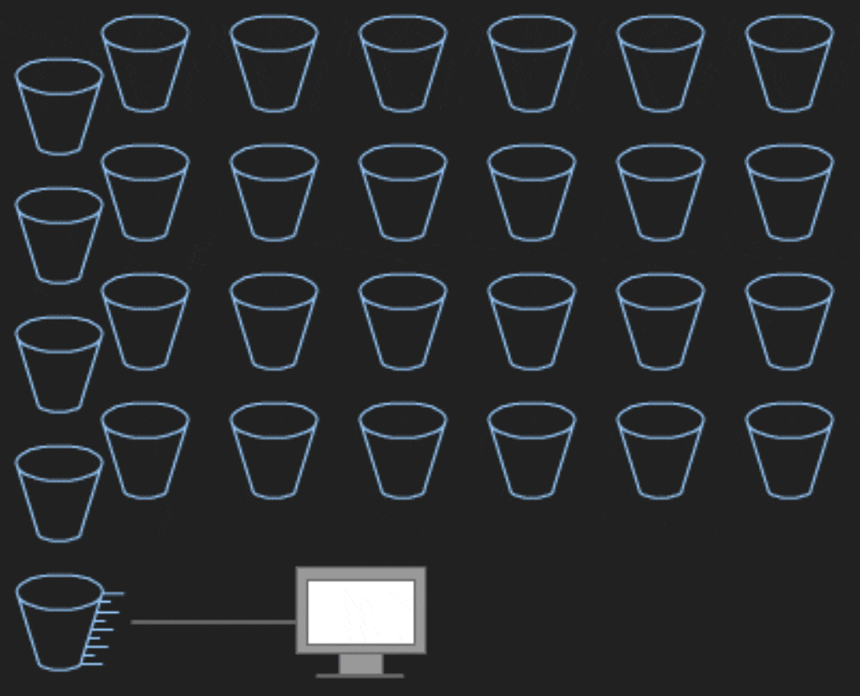
Types of sensors
https://www.photometrics.com/learn/camera-basics/types-of-camera-sensor
https://www.canon-europe.com/pro/infobank/image-sensors-explained/
Notes:
8 bits per channel
Store energy in the scene
View, color, energy mapping

Slide 50
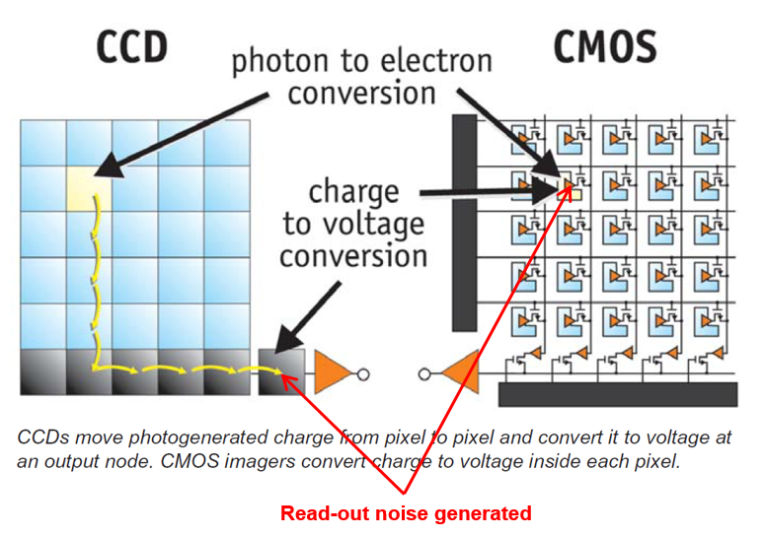
Types of sensors
Read more here, and on this canon website (marketing-speak alert)
Notes:
8 bits per channel
Store energy in the scene
View, color, energy mapping

Slide 51



Slide 52
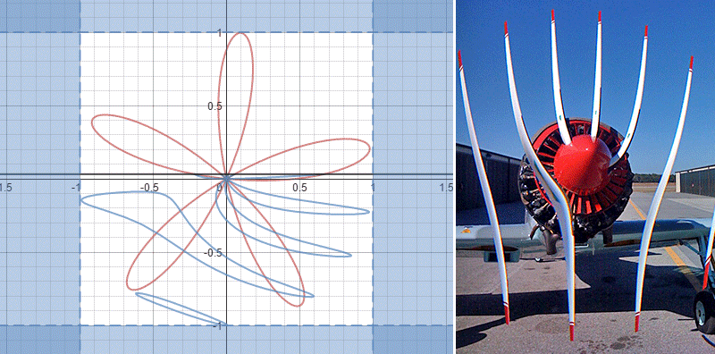
Rolling shutter

Slide 53
The big picture!

Slide 54
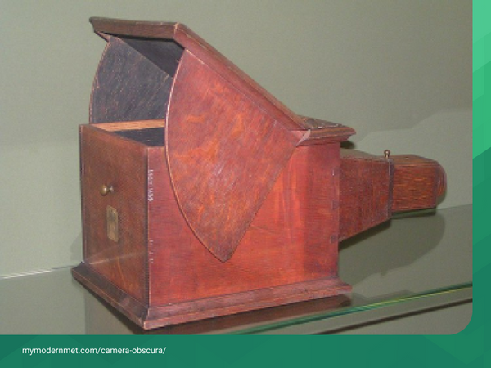
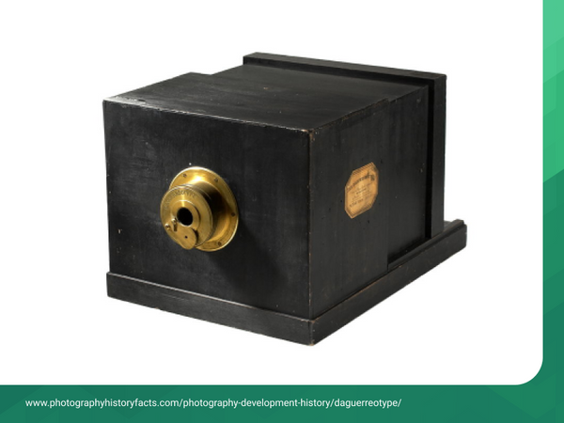
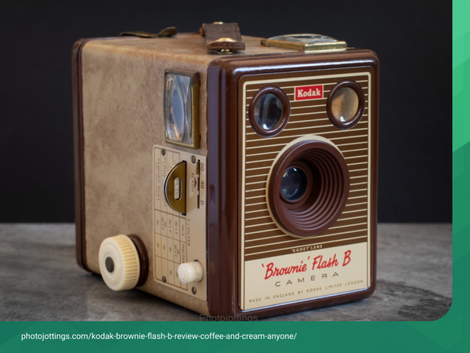
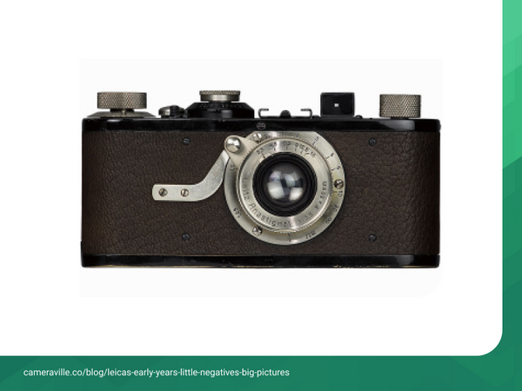
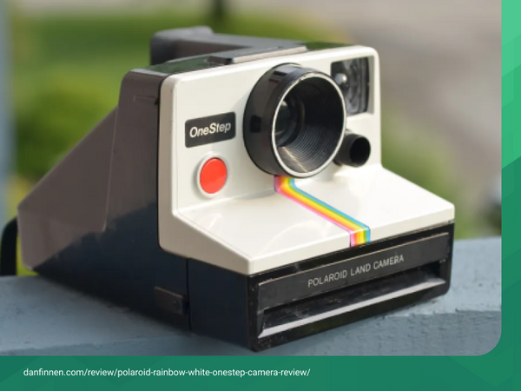
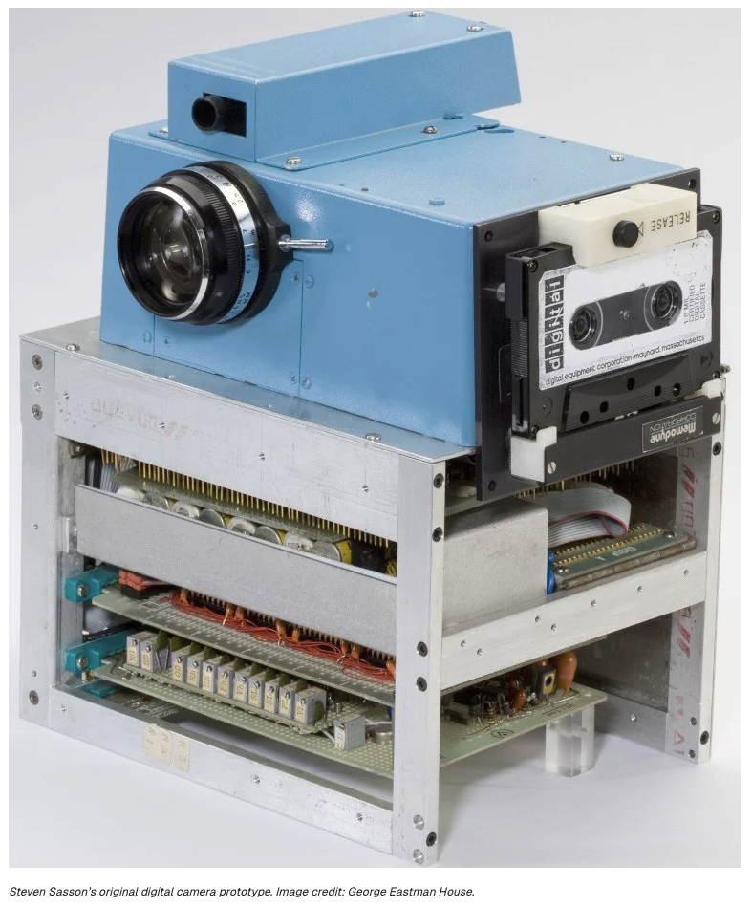
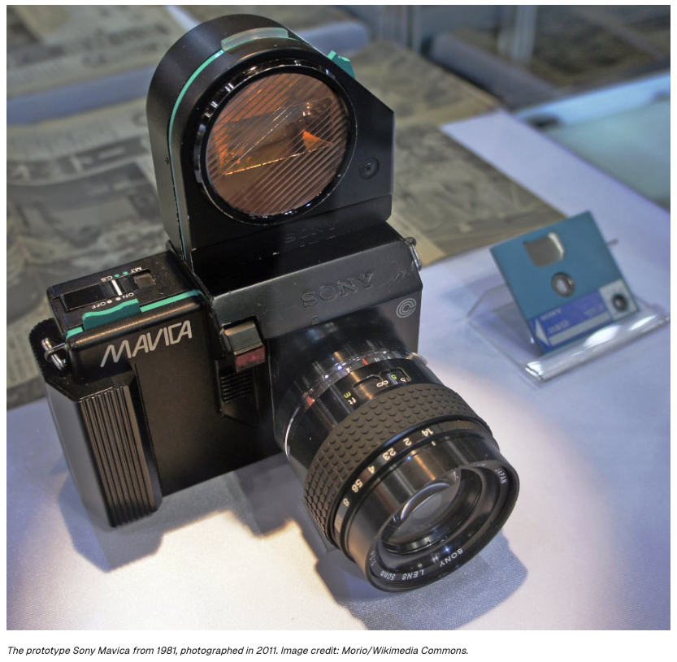
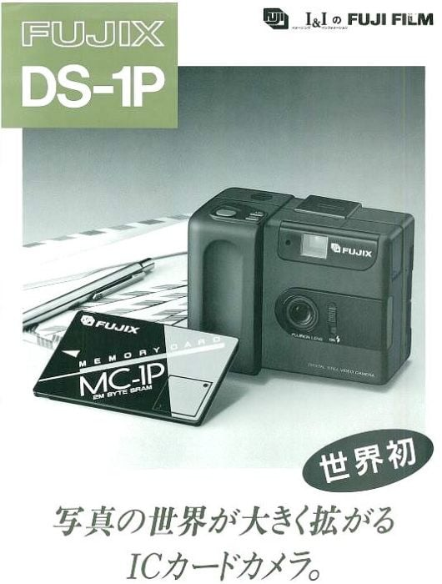
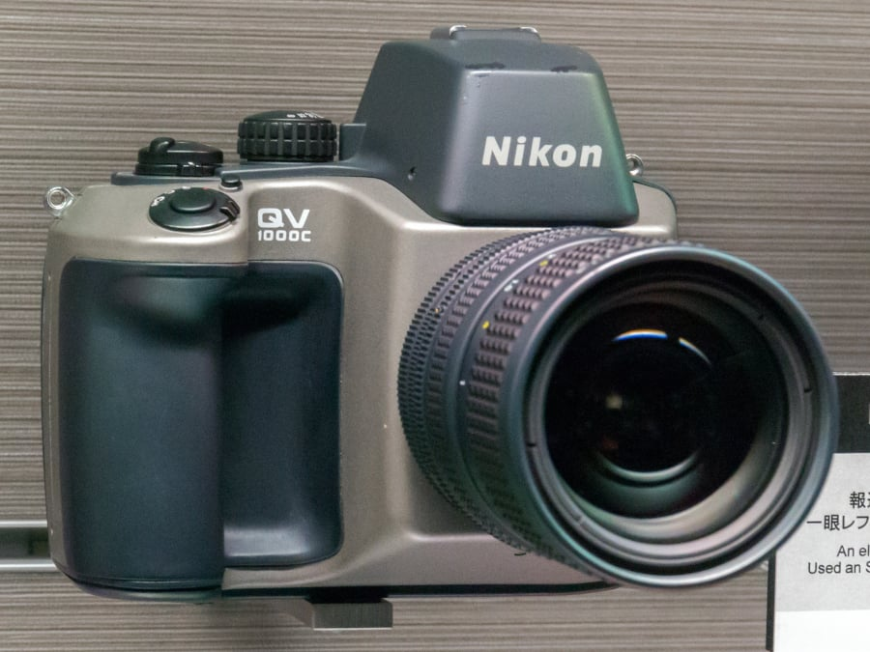
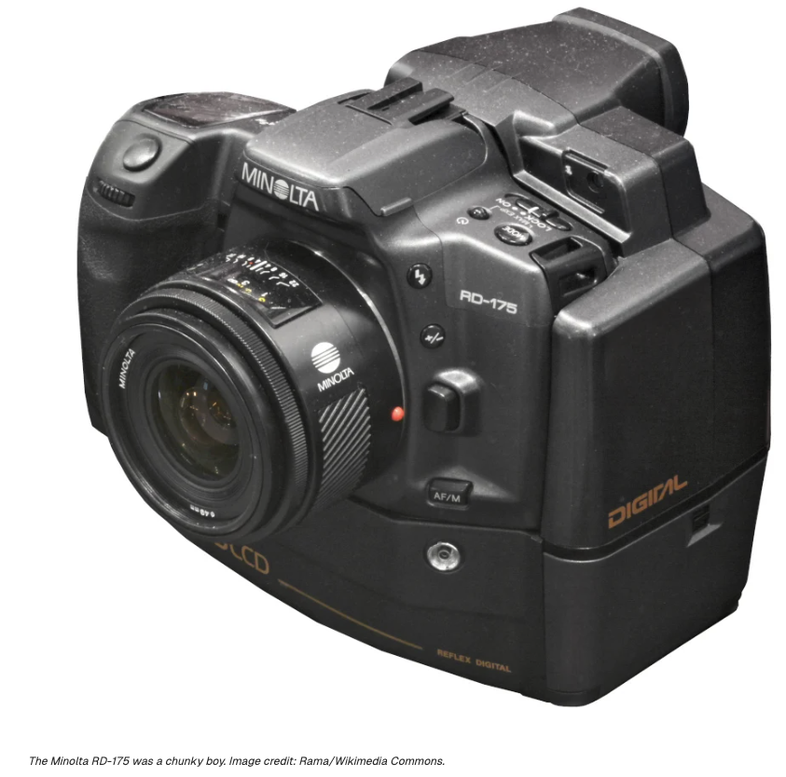
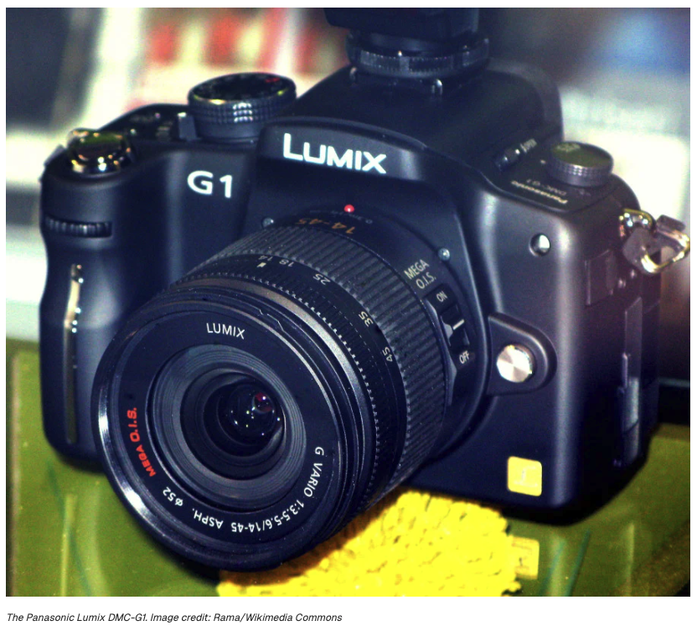
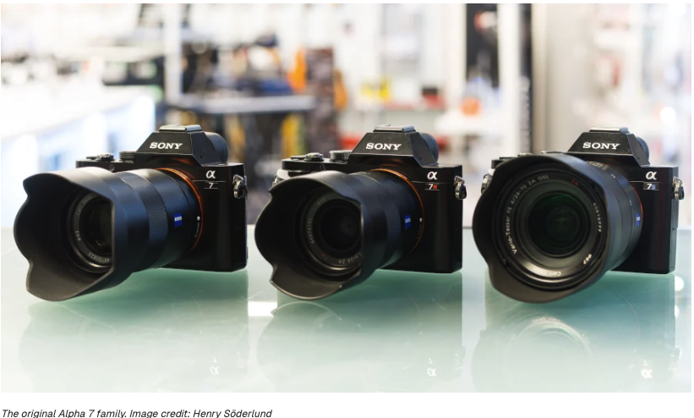
1750
1839
1888
1934
1990s
1988
digital
1975
1981
mirrorless

Slide 55
https://www.techradar.com/phones/iphone/iphone-17-lineup-photography-specs-explained-fusion-camera-center-stage-and-48mp-mode

Slide 56
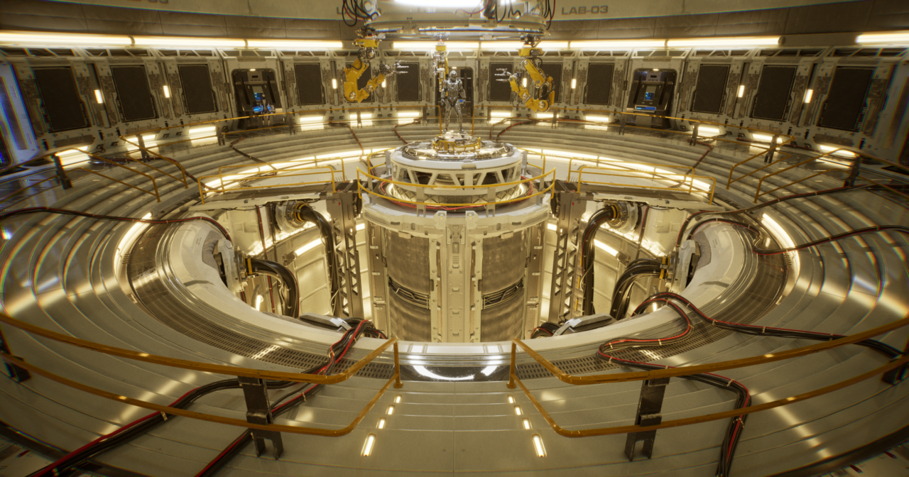
Accounting for camera in rendering
https://blogs.nvidia.com/blog/what-is-path-tracing/

Slide 57
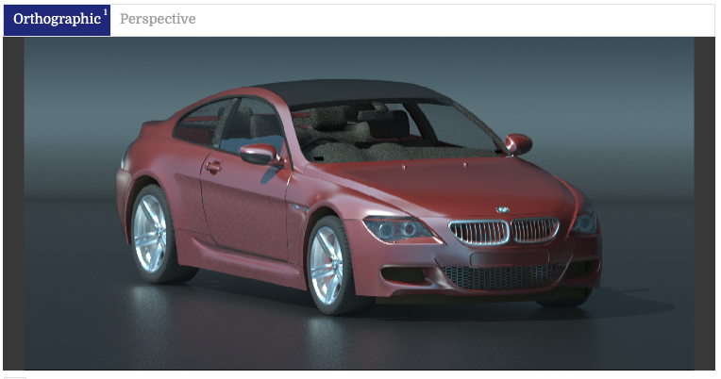
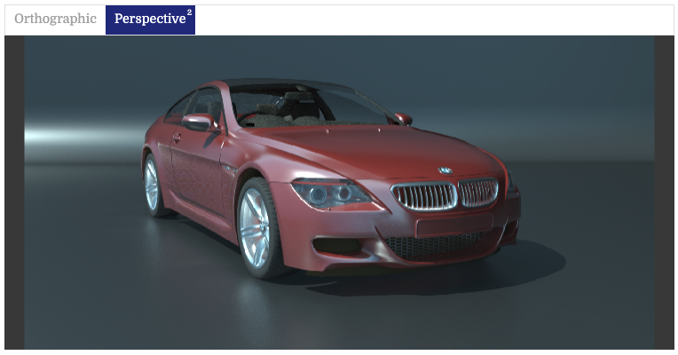
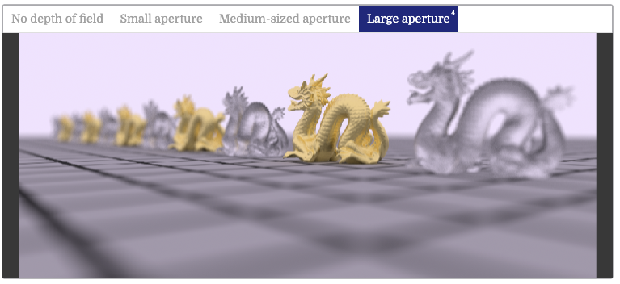
Accounting for camera in rendering
https://pbr-book.org/3ed-2018/Camera_Models/Projective_Camera_Models

